Slide 1
Inheritance and Polymorphism in PHP (OOP)

Slide 2
Learning Objectives
1. By the end of this lesson, you should be able to:
2. Understand the concept and purpose of inheritance in OOP.
3. Understand the relationship between base and derived classes.
4. Demonstrate method overriding to customize inherited behavior.
5. Use the parent:: keyword to enhance inherited methods in derived classes.
6. Explain and implement polymorphism using a common base class.

Slide 3
What is Inheritance?
Inheritance allows a class to reuse the properties and methods of another class.
The base class is also called the parent class.
The derived class is also called the child class.
Promotes code reuse and modularity.

Slide 4
Roles of Base and Derived Classes
Role | Description
Base Class | The general class (e.g., Person)
Derived Class | The specialized class (e.g., Student)

Slide 5
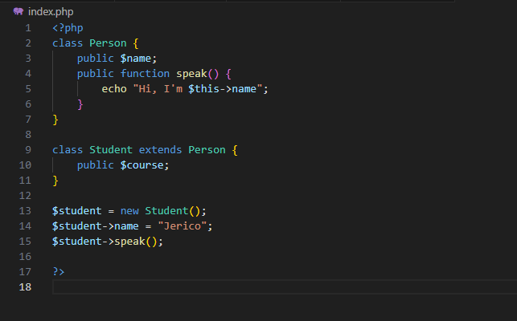
SYNTAX EXAMPLE
Notes:
<?php
class Person {
public $name;
public function speak() {
echo "Hi, I'm $this->name \n";
}
}
class Student extends Person {
public $course;
public function introduce() {
echo "My name is " . $this->name . " and I'm studying $this->course \n";
}
}
$student = new Student();
$student->name = "Jerico";
$student->course = "Computer Science";
$student->introduce();
?>

Slide 6
What is Method Overriding?
Method overriding allows a child class to redefine a method from the parent class.
Used to customize or change inherited behavior.

Slide 7
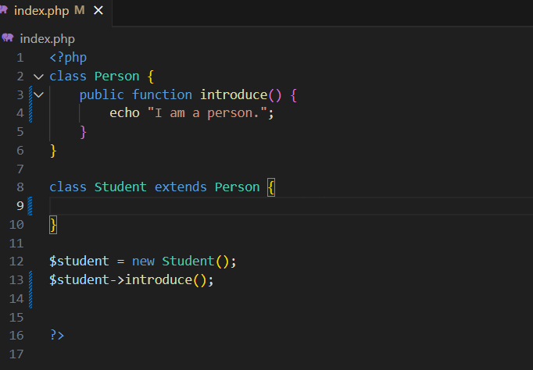
SYNTAX EXAMPLE
Notes:
<?php
class Person {
public function introduce() {
echo "I am a person.";
}
}
class Student extends Person {
public function introduce() {
echo "I am a student.";
}
}
$student = new Student();
$student->introduce();
?>

Slide 8
Using parent:: to Extend Behavior
Use parent::methodName() to call the original method from the parent class.
Useful when the child needs to extend, not fully replace, the behavior.

Slide 9
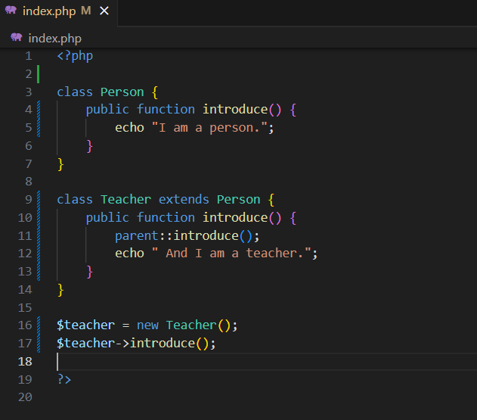
SYNTAX EXAMPLE

Slide 10
What is Polymorphism?
Polymorphism means one interface, many behaviors.
Different classes can implement the same method name differently.
Achieved through method overriding.

Slide 11
Concept of Polymorphism
All child classes inherit from the same base.
Each class overrides a method (e.g., introduce()).
You can treat them as the same type (e.g., Person) in your code.

Slide 12
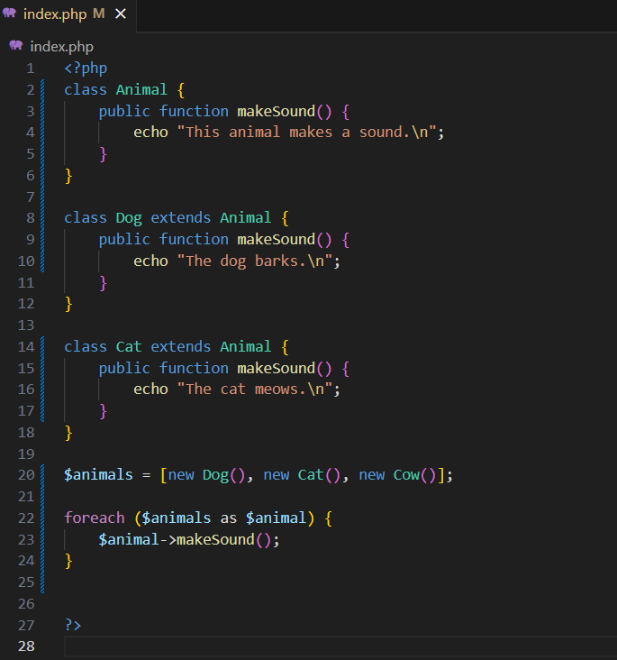
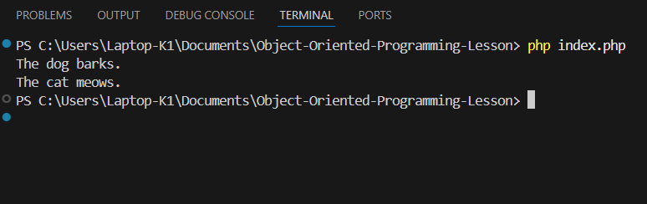
SYNTAX EXAMPLE
Notes:
Animal is the base class with a general makeSound() method.
Dog, Cat, and Cow are derived classes that override makeSound().
The foreach loop treats all objects as Animal but they respond differently — this is polymorphism.

Slide 13
Summary
Concept | Description
Inheritance | Share and reuse code using base and derived classes
Method Overriding | Redefine inherited methods to customize behavior
parent:: | Extend inherited method logic using the parent keyword
Polymorphism | Use the same method across different objects with different behavior

Slide 14
Thank you

